Slide 1


Slide 2
Presentation
Hypothesis: Investigate which company category is receiving the most funding and in which regions.
Dataset:
Crunchbase Companies, Investments and Acquisitions.
Name: Rose Nkwelle.
Navigating SF Bay Area: Solutions for Investors and Entrepreneurs.

Slide 3
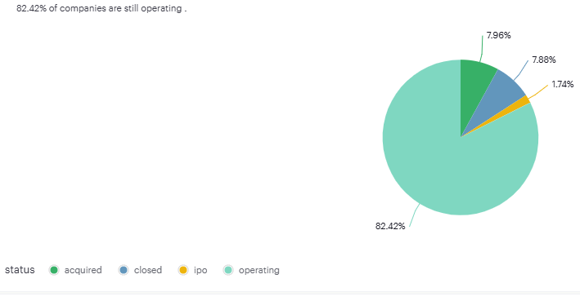
Status of Companies
Notes:
Majority of companies are operating ,encouraging to invest or acquire companies.

Slide 4
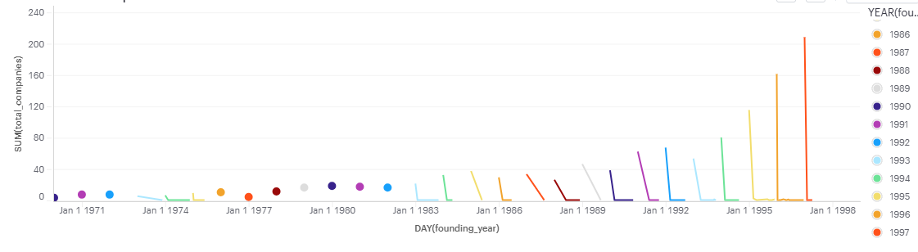
Growth of Companies Over Time.
Notes:
Companies grow over time ,this implies that companies have possibility to diversify their products, services or geographic reach , reducing risks associated with reliance on a single market. Furthermore, growth often comes with in research and development enabling companies to stay competitive through innovation.

Slide 5
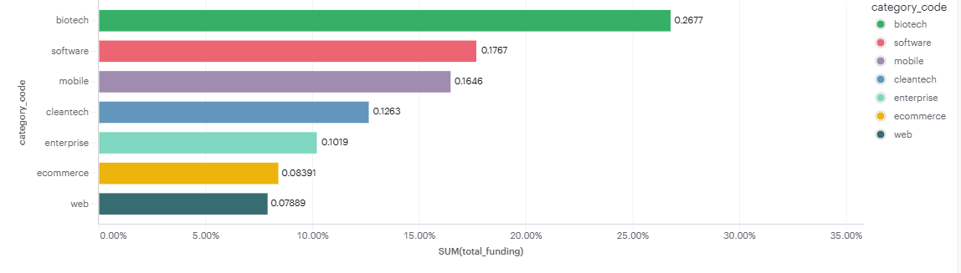
Total Funding Per Category
Notes:
Industry Dynamics: Sectors like biotech or cleantech often require significant upfront investments with long timelines before profitability due to research, development, and regulatory hurdles.
Market Potential: High funding often reflects investor confidence in market potential or future profitability, but it doesn’t guarantee actual profits.
Profitability Metrics: To evaluate profitability, look at financial metrics like net income, profit margins, and return on investment (ROI) rather than just funding levels.
Consider Software and Mobile: These sectors rank second and third in funding (17.67% and 16.46%, respectively), indicating robust growth opportunities.

Slide 6
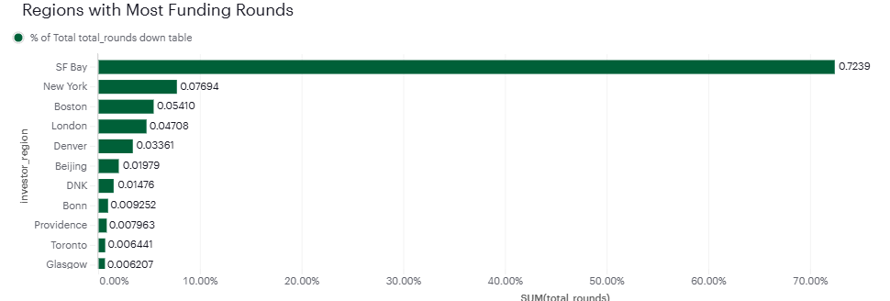
Which region has the most funding rounds?
Notes:
Prioritize SF Bay Area: With 72.39% of total funding rounds, SF Bay dominates as the leading region for investment opportunities.
Explore Secondary Hubs: New York (7.69%) and Boston (5.41%) also show significant activity, making them strong alternatives for diversification.
Be Selective in Smaller Regions: Regions like Toronto, Glasgow, and Providence have minimal funding rounds, suggesting lower investment activity and potential.

Slide 7
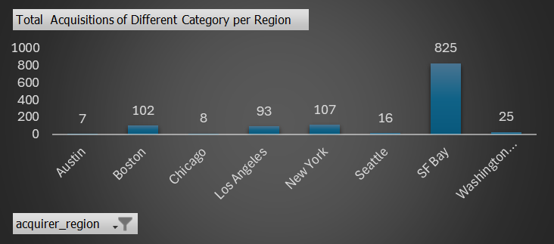
Where do you want to invest/acquire a company?
Notes:
SF Bay is the most active hub offering high growth and investment opportunities
Investors can diversify in New York and Boston.
Avoid Low-Activity Markets: Cities like Austin, Chicago, and Seattle show minimal acquisitions in both regions, suggesting lower potential returns on investment.

Slide 8
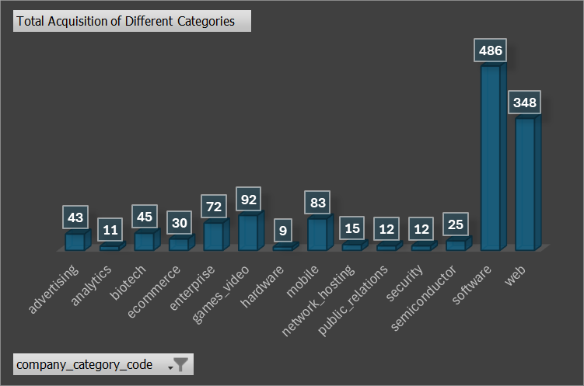
Acquisition Pattern of Category codes
Notes:
Recommendation for investors
Investor should consider opportunities in web and game video industries focusing on innovative technologies.
Prioritize software over Web : The software sector has significantly higher overall acquisitions, indicating a more vibrant market for investors.

Slide 9


Slide 10
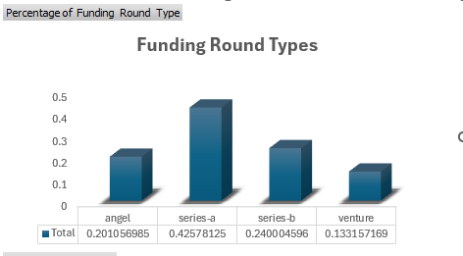
What type of Investor are you looking for?
Notes:
Focus on Series-A Funding: With the highest percentage (42.57%), Series-A rounds indicate a prime stage for investment with solid growth potential
.Consider Series-B for Scalability: Series-B funding (24.00%) represents companies scaling operations, offering opportunities for higher returns.
Balance Risk with Angel Investments: While lower (20.11%), angel investments allow entry into early-stage startups, suitable for investors seeking higher-risk, high-reward opportunities.

Slide 11
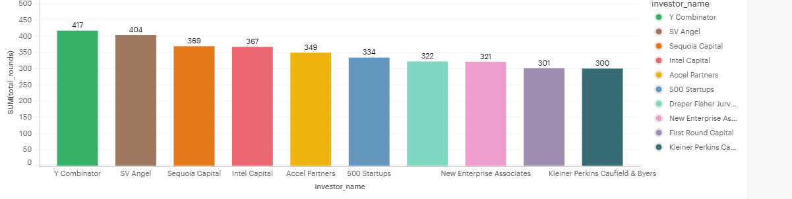
Who Can be a Suitable Investor?
Notes:
Y Combinator has the highest funding rounds on angel funding type in SF Bay.
SV Angel has the second highest on Angel and series-a funding type and
Sequoia Capital is 3rd on the list investing as venture and series-b.
.

Slide 12
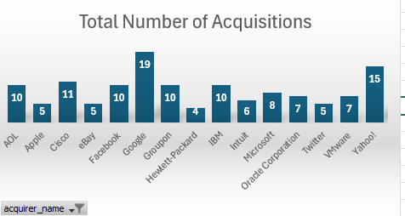
Who can be a suitable acquirer of your company?
Notes:
Invest in startups aligned with Google and Yahoo's acquisition focus, such as AI and cloud computing.
Target industries favored by Apple, Cisco, and Facebook, like consumer tech and networking.
Explore opportunities in enterprise software and hardware, areas of interest for IBM and Hewlett-Packard.
Prioritize startups in innovation hubs like the SF Bay Area to attract acquirers.

Slide 13


Slide 14
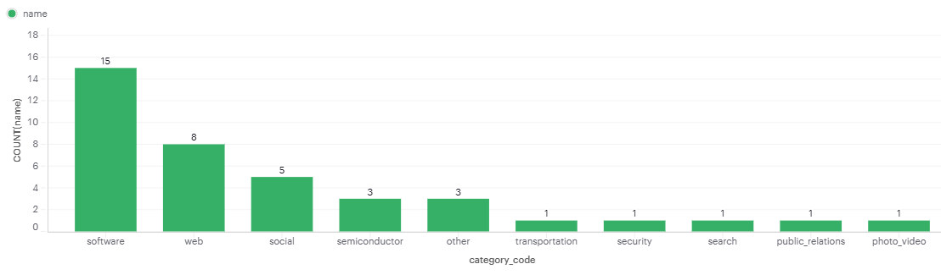
Trend of Closure in SF Bay Region
Notes:
Software: Intense competition leads to market saturation, making differentiation key.

Slide 15
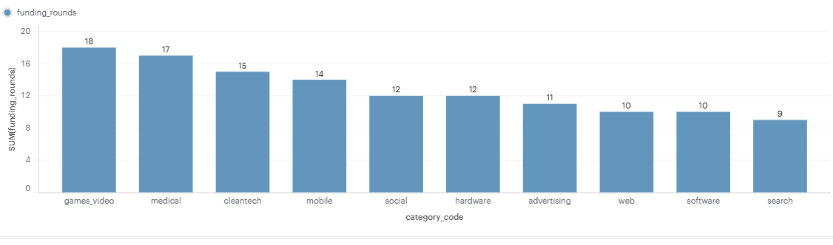
Funding Rounds for Closed Companies Category
Notes:
Industries like Games Video and Medical benefit from multiple rounds of funding. However, higher funding rounds might not always correlate with higher success rates.
The software industry demonstrates the importance of efficient use of funds and quicker turnaround in securing profitability.

Slide 16
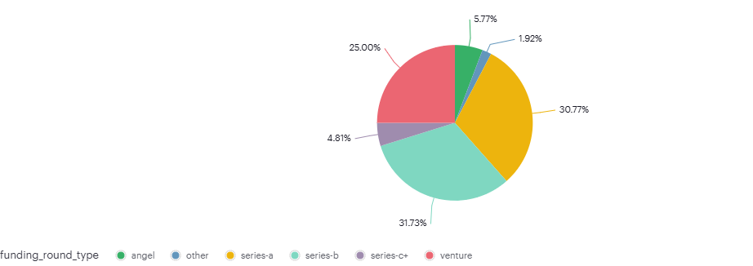
Percentage of Funding Type for Closed Companies in SF Bay Region.
Notes:
High Closure at Series-b and Series-a:
Companies might have struggled with scaling up operations and securing long-term sustainability.
Declining Closures in Later Stages (Series-C+):
Suggests that companies reaching Series-C or beyond are better equipped to navigate challenges.
Investors may also be more selective at later stages, leading to fewer closures.
Angel funded companies highlights the importance of strong business models and market validation early on.

Slide 17
Conclusion
For Investors:
Diversify portfolios to manage risks, especially in industries with high funding needs like Biotech.
For Games Video and Software, focus on companies with innovative offerings and strong market positioning.
For Startups:
Assess industry-specific funding needs and align business strategies accordingly.
Prioritize operational efficiency, especially in sectors with limited funding rounds (e.g., Software).

Slide 18
Thank You. Contact: rosenkwelle@gmail.com

